Slide 1
Improving the Risk-Finance Paradigm
Siwei Gao
Fox School of Business, Temple University
Michael R. Powers
School of Economics and Management, Tsinghua University
Thomas Y. Powers
School of Business, Harvard University

Slide 2
Conventional R-F Paradigm
Expected Severity | High | TRANSFER (Hedging) | AVOIDANCE (through Risk Control)
 | Low | POOLING (Informal Diversification) | POOLING (Diversification)
 |  | Low | High
 |  | Expected Frequency

Slide 3
Conventional R-F Paradigm
Problems:
(A) Suggests insurers always exist to assume (and presumably pool) low expected frequency/high expected severity (i.e., catastrophe) losses
(B) Implies inconsistent effect of increasing expected frequencies (i.e., diversification) on losses with low, as opposed to high, expected severities

Slide 4
Approach
Develop mathematical model of loss portfolio to account for changes in severity tail heaviness (and therefore effectiveness of diversification)
Identify criteria to distinguish among pooling, transfer, and avoidance
Study morphology of boundary curves between different risk-finance regions
Assess practical implications, especially for heavy tail losses and catastrophe losses

Slide 5
Basic Model
Loss portfolio: L = X₁ + . . . + X_{n}
Frequency: n is non-stochastic
Severity: X₁, . . ., X_{n} ~ i.i.d. Lévy-Stable (α, β, γ, δ) for α > 1 (i.e., finite mean)

Slide 6
Basic Model
From generalized CLT, Lévy-Stable (α, β, γ, δ) ~ approx. Pareto II (a, θ) for:
a if a ∈ (1, 2) 1 if a ∈ (1, 2)
2 if a > 2 0 if a > 2
θ if a ∈ (1, 2)
θ / [2^{1/2} (a-1) (a-2)^{1/2}] if a > 2
θ / (a-1) + θ tan(πa/2) if a ∈ (1, 2)
θ / (a-1) if a > 2
α =
β =
γ =
δ =

Slide 7
A Simple Risk Measure
Family of cosine-based risk measures:
CBSD[X] = (1/ω) cos⁻¹(E[cos(ω(X-τ))])
CBVar[X] = (2/ω²) {1 - E[cos(ω(X-τ))]},
where ω > 0 optimizes info.-theoretic criterion
Expressions for Lévy-stable family:
CBSD[X] = cos⁻¹(exp(-1/2)) 2^{1/α} γ ≈ (0.9191) 2^{1/α} γ
CBVar[X] = 2 [1 - exp(-1/2)] (2^{1/α} γ)²
≈ (0.7869) (2^{1/α} γ)²
Proposed risk measure: R[X] = (2^{1/α} γ)^{s}, s > 1

Slide 8
Firm Decision Making
Select pooling over transfer iff firm’s “expected cost” is less than firm’s “expected benefit”; i.e.,
R[L] / E[L] < k for some k > 0, which yields:
E[X] < k ^{-1/(1-s)} 2^{s/a(1-s)} (a-1)^{s/(1-s)} n^{(s-a)/a(1-s)}
for a ∈ (1, 2);
E[X] < k ^{-1/(1-s)} (a-2)^{-s/2(1-s)} n^{(s-2)/2(1-s)}
for a > 2

Slide 9
Firm Decision Making
Select transfer over avoidance iff insurer’s “expected cost” is less than insurer’s “expected benefit”; i.e.,
R[L] / E[L] < k_{I} for some k_{I} > 0:
E[X] < k_{I}^{-1/(1-s)} 2^{s/a(1-s)} (a-1)^{s/(1-s)} n^{(s-a)/a(1-s)}
for a ∈ (1, 2);
E[X] < k_{I}^{-1/(1-s)} (a-2)^{-s/2(1-s)} n^{(s-2)/2(1-s)}
for a > 2

Slide 10
Type I R-F Paradigm
Expected Severity
AVOIDANCE
TRANSFER
POOLING
Expected Frequency

Slide 11
Type II R-F Paradigm
Expected Severity
AVOIDANCE
TRANSFER
POOLING
Expected Frequency

Slide 12
Type III R-F Paradigm
Expected Severity
AVOIDANCE
TRANSFER
POOLING
Expected Frequency

Slide 13

Boundary-Curve Regions
2.5
2.0
TYPE I
s
TYPE II
1.5
TYPE III
1.0
1.0
1.5
$$a$$
2.0
2.5

Slide 14
A Conservative Paradigm
Regarding effectiveness of diversification, Type I boundary is most conservative
Regarding ability to transfer catastrophe losses, Type III boundary is most conservative
In latter case, Type I can be made most conservative for sufficiently large n; however, critical values of n approach infinity as a → 2⁺ (Gaussian with infinite variance)

Slide 15


Conservative R-F Paradigm
High
AVOIDANCE
Expected
Severity
TRANSFER
Low
POOLING
$$n^{∗} Insurer$$
$$n^{∗} Firm$$
Low
High
Expected Frequency
Offset apexes: Firm’s k less than insurer’s k_{I}

Slide 16

Conservative R-F Paradigm
High
AVOIDANCE
Expected
Severity
TRANSFER
Low
POOLING
$$n^{∗} Firm$$
Low
High
Expected Frequency
No upper apex if insurer’s k_{I} sufficiently large

Slide 17
Conventional R-F Paradigm
Expected Severity | High | TRANSFER (Hedging) | AVOIDANCE (through Risk Control)
 | Low | POOLING (Informal Diversification) | POOLING (Diversification)
 |  | Low | High
 |  | Expected Frequency

Slide 18
Stochastic Frequency
Loss portfolio: L = X₁ + . . . + X_{N}
Frequency:
Case (1), N ~ Poisson (λ), λ > 0 varies,
CV[N] → 0 as E[N] → infinity
Case (2), N ~ Shifted Negative Binomial (r, p),
r > 0 fixed, p ∈ (0, 1) varies,
CV[N] → r ^{-1/2} > 0 as E[N] → infinity
Severity: X₁, . . ., X_{n} ~ i.i.d. Pareto II (a, θ)
for a > 1 (i.e., finite mean)

Slide 19
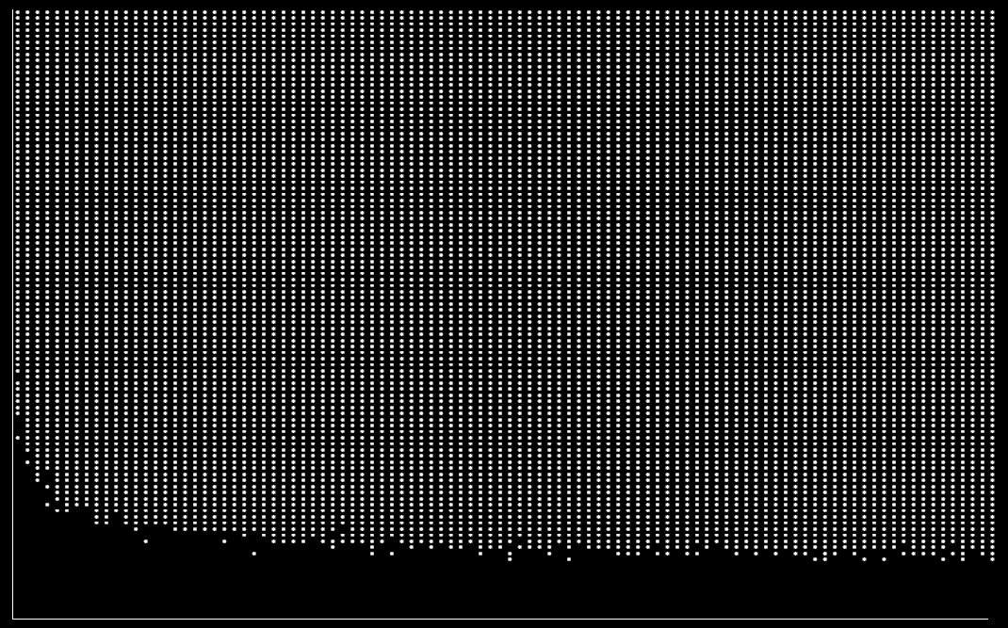
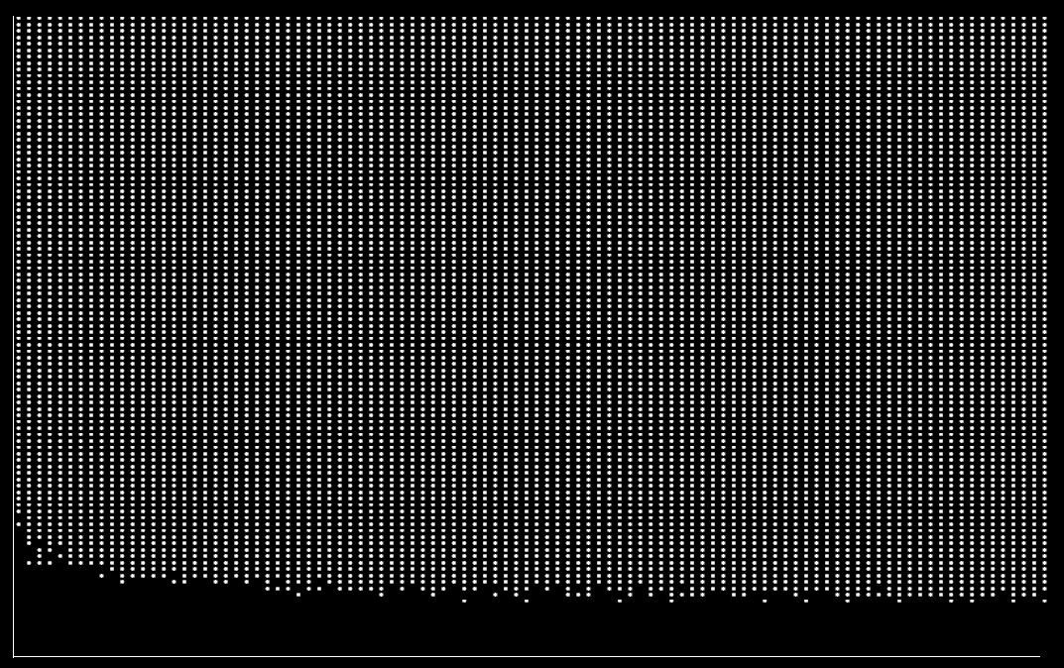
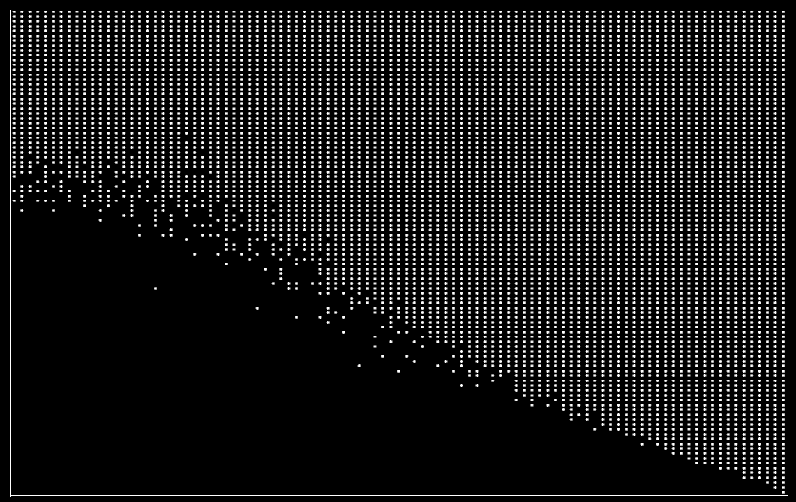
Simulation Results (Type I)
a = 1.5 (heavy-tailed), s = 1.6, k = 115
Fixed
Poisson
Shifted NB
Expected
Severity
(Pareto II)
Expected Frequency
Expected Frequency
Expected Frequency

Slide 20
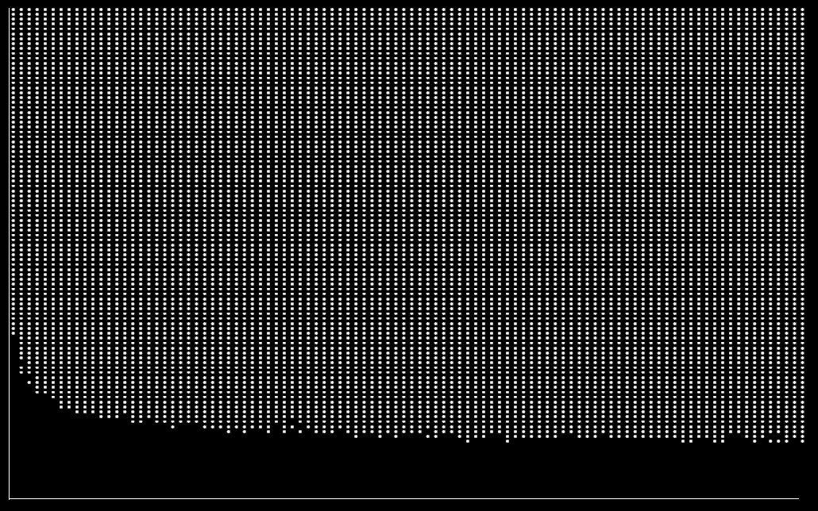
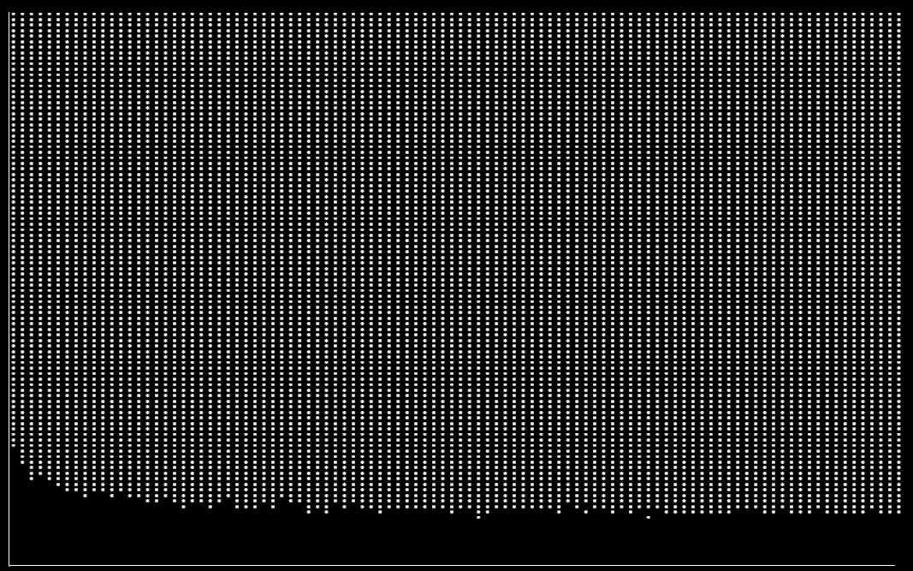
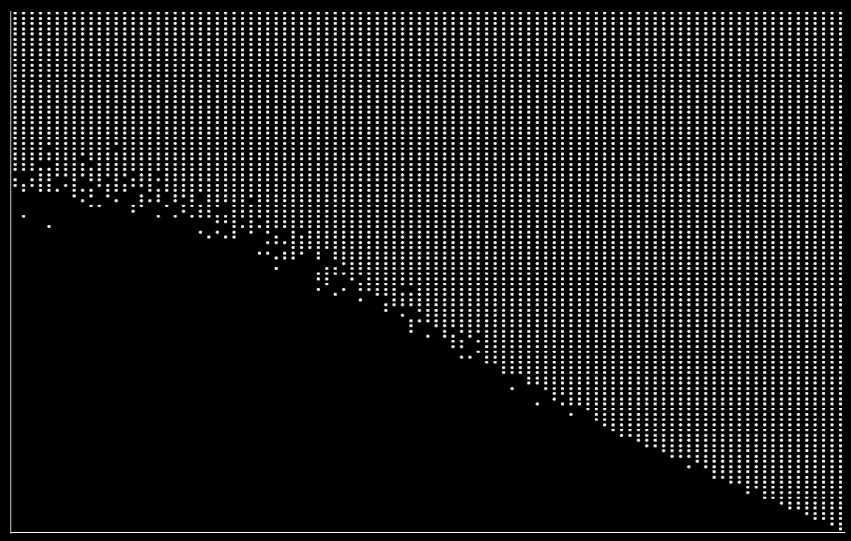
Simulation Results (Type I)
a = 2.5 (light-tailed), s = 2.1, k = 3100
Fixed
Poisson
Shifted NB
Expected
Severity
(Pareto II)
Expected Frequency
Expected Frequency
Expected Frequency

Slide 21
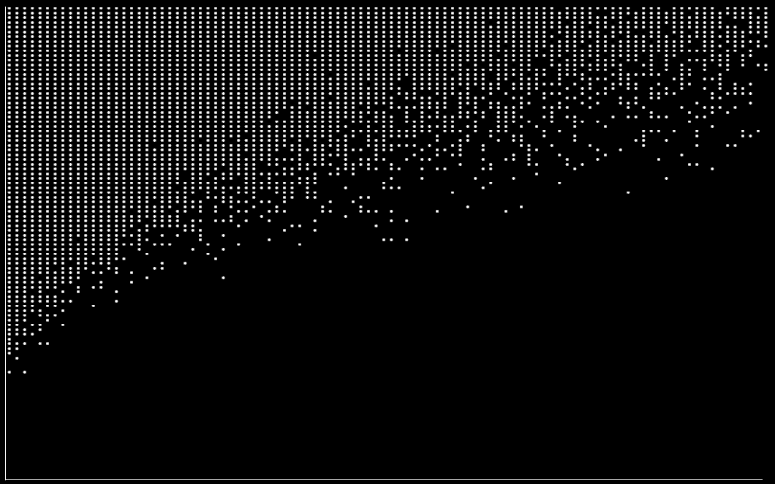
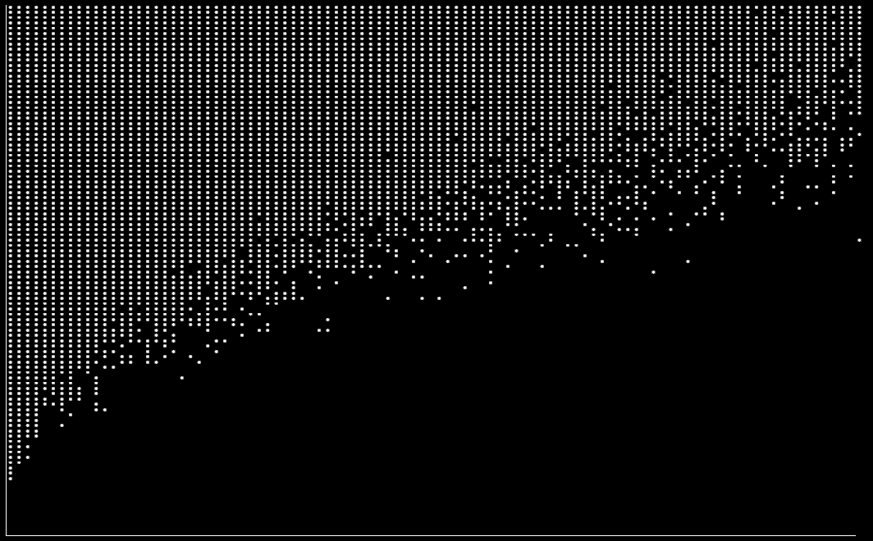
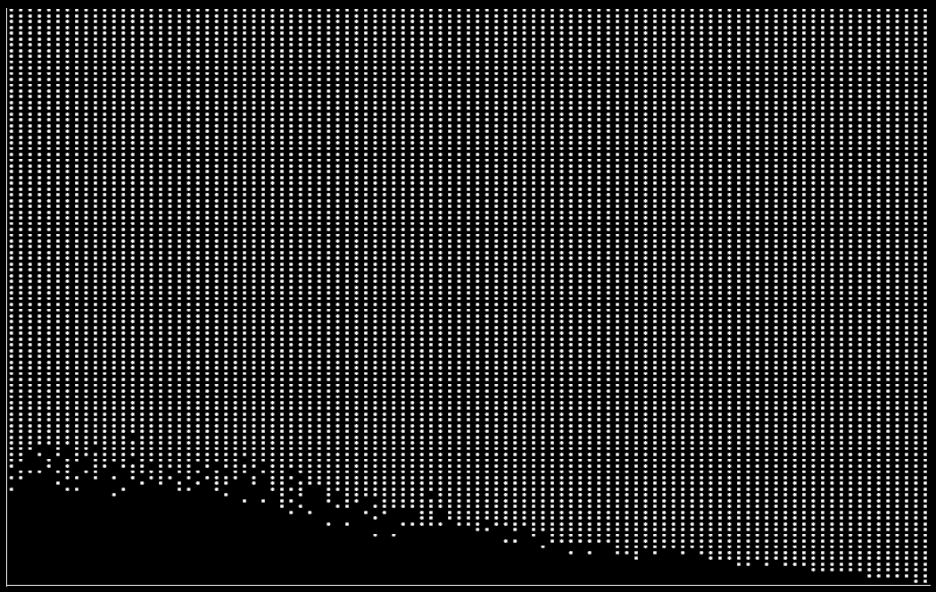
Simulation Results (Type II)
a = 1.5 (heavy-tailed), s = 1.3, k = 6
Fixed
Poisson
Shifted NB
Expected
Severity
(Pareto II)
Expected Frequency
Expected Frequency
Expected Frequency

Slide 22
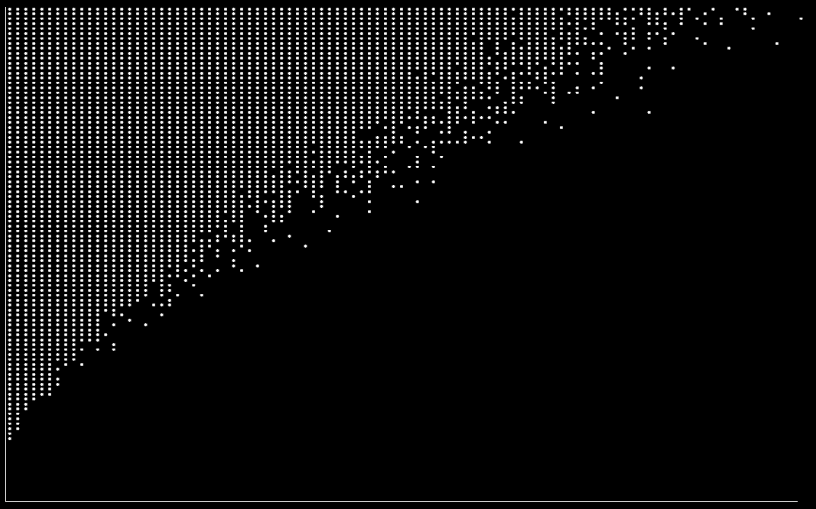
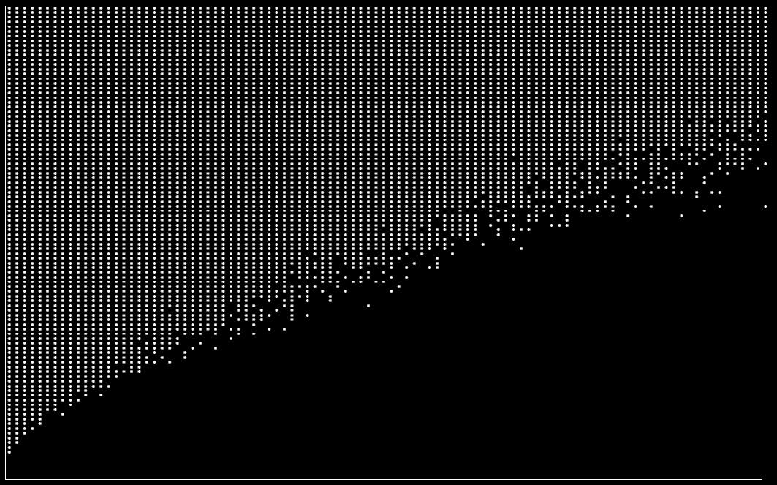
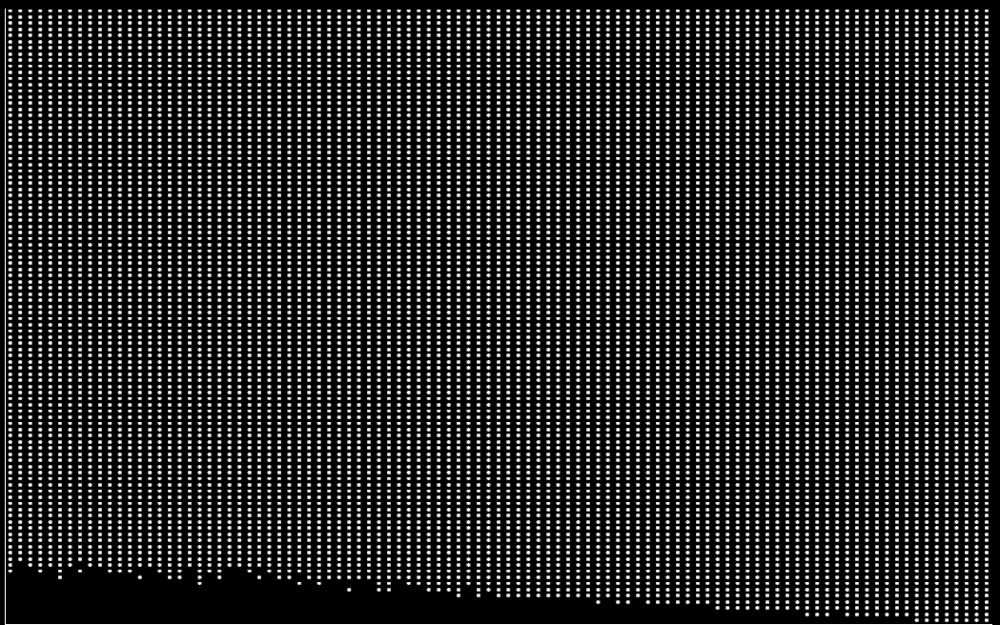
Simulation Results (Type II)
a = 2.5 (light-tailed), s = 1.4, k = 5.5
Fixed
Poisson
Shifted NB
Expected
Severity
(Pareto II)
Expected Frequency
Expected Frequency
Expected Frequency

Slide 23
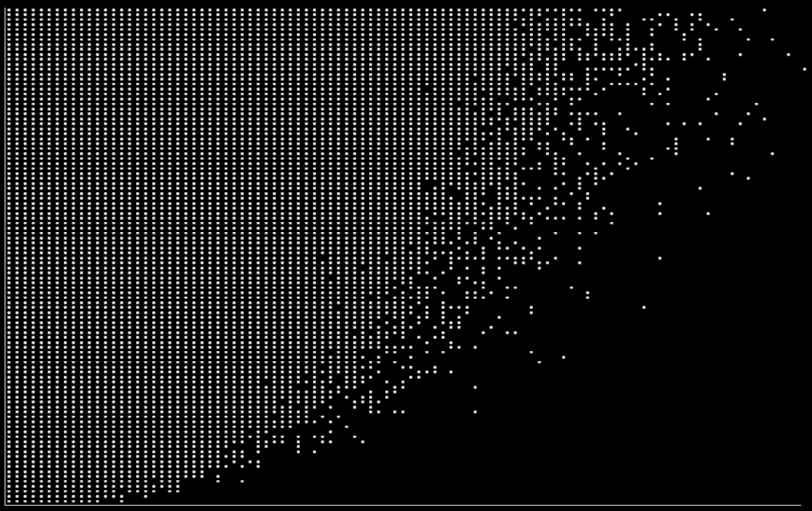
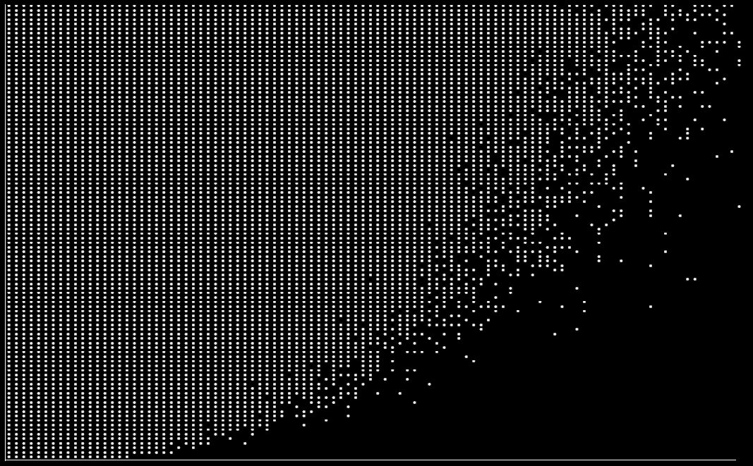
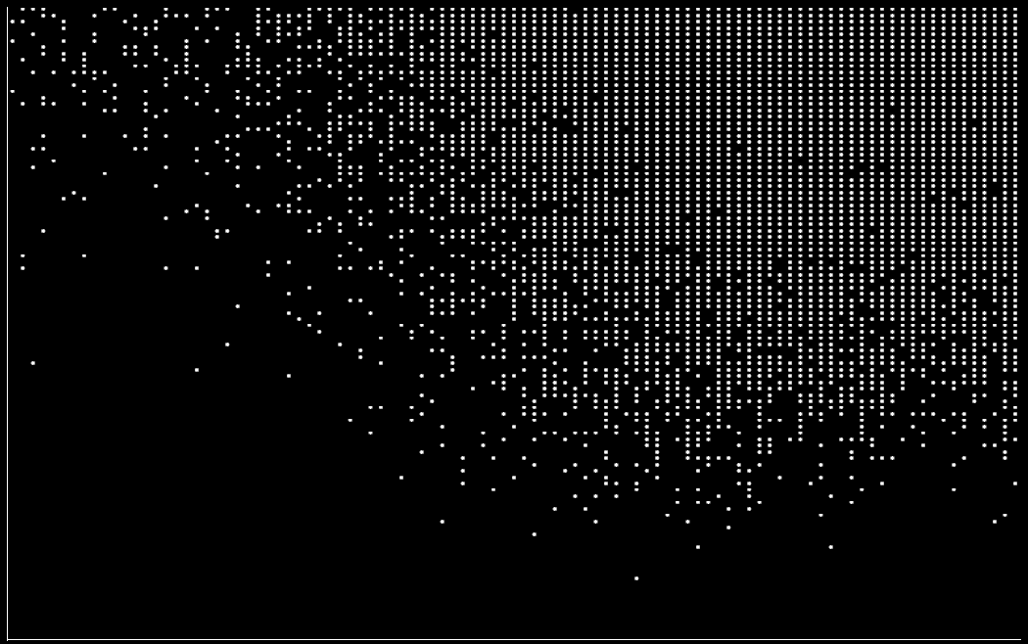
Simulation Results (Type III)
a = 1.5 (heavy-tailed), s = 1.1, k = 0.38 (F, P); 1.6 (SNB)
Fixed
Poisson
Shifted NB
Expected
Severity
(Pareto II)
Expected Frequency
Expected Frequency
Expected Frequency

Slide 24
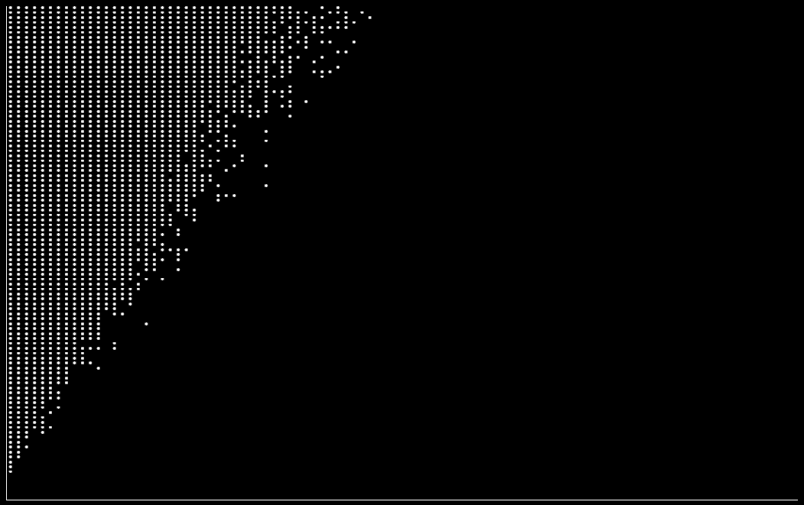
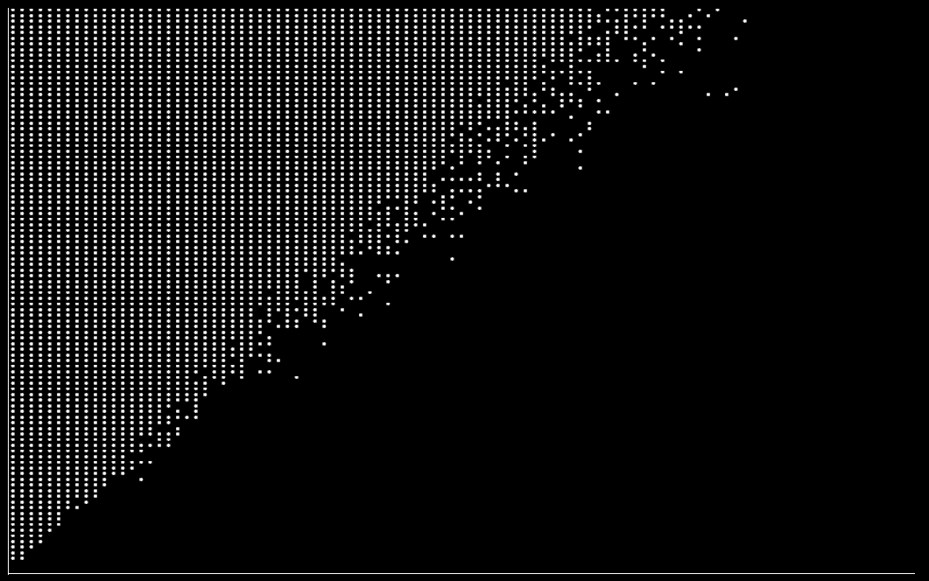
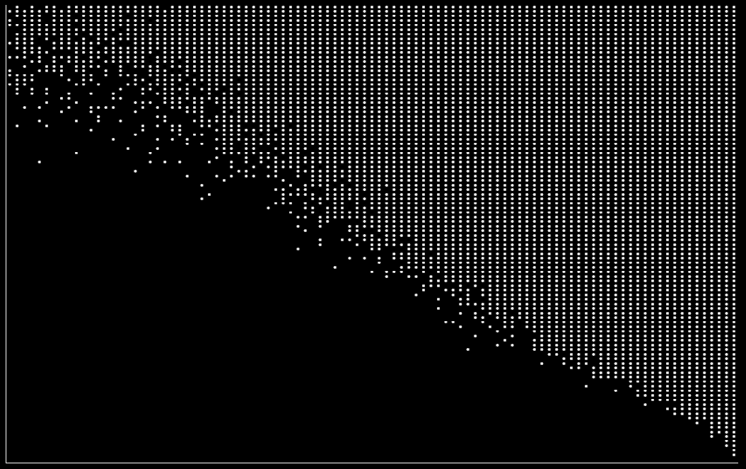
Simulation Results (Type III)
a = 2.5 (light-tailed), s = 1.3, k = 2 (F, P); 6 (SNB)
Fixed
Poisson
Shifted NB
Expected
Severity
(Pareto II)
Expected Frequency
Expected Frequency
Expected Frequency

Slide 25
Causes of Decreasing Boundary
Heavy-tailed severity (Smaller a)
Diminished intrinsic effects of diversification
High sensitivity to risk (Larger s)
Diminished perceived effects of diversification
CV[N] > 0 as E[N] → infinity (e.g., Shifted NB)
Ineffective “law of large numbers”

Slide 26
Further Research
Practical implications of non-monotonic boundaries
Shifted Negative Binomial frequency with a < 2 (heavy-tailed severity) and small s > 1 (low sensitivity to risk)

Slide 27
References
Baranoff, E., Brockett, P. L., and Kahane, Y., 2009, Risk Management for Enterprises and Individuals, Flat World Knowledge, http://www.flatworldknowledge.com/node/29698#web-0
Nolan, J. P., 2008, Stable Distributions: Models for Heavy-Tailed Data, Math/Stat Department, American University, Washington, DC

Slide 28
References
Powers, M. R. and Powers, T. Y., 2009, “Risk and Return Measures for a Non-Gaussian World,” Journal of Financial Transformation, 25, 51-54
Zaliapin, I. V., Kagan, Y. Y., and Schoenberg, F. P., 2005, “Approximating the Distribution of Pareto Sums,” Pure and Applied Geophysics, 162, 6-7, 1187-1228

