Slide 1
Delivery not distribution: Time to revisit our industry architecture
CICIRM, 2013
KUNMING, CHINA
PRAVEEN GUPTA MA, Dip. DM, FCII, FIII, CHARTERED INSURER
MANAGING DIRECTOR & CEO
RAHEJA QBE GENERAL INSURANCE CO. LTD.
MUMBAI

Slide 2
Agenda
Why delivery and not distribution as the focus of attention and action?
What is the keystone of current architecture?
Why change? Did we ask the customer?
Drivers of change?
Alternatives?
Prescriptions for reviving delivery?

Slide 3
Delivery not Distribution* :
Tend to be used as synonyms. Owing to growth opportunities, sales becomes a dominant mode leading to the spurt in distribution!
Many of the woes in financial services emanate from an over-emphasis on distribution. Emerging markets need to beware!
“Treating Customers Fairly” is still off the radar. Tendency to imitate the channels but disregard readiness and suitability!
Aside from the reputational risks, a client no longer a company’s property but a prisoner of the channel that acquired him or her!
Delivery is service driven; unfortunately and increasingly insurance is being configured as a sales organisation. Mutates the personality and behavior into something inherently contradictory!
*Thinkpiece No 91 ; CII (UK), November 2012

Slide 4
What is the current architecture?
Point-of-Sale centric : Fault Lines
  Be this an organisation; channels; partners!
  Topline; growth; penetration; density!
  ‘One year contract’!
  Price as a reinforcer – customer does not even remember the brand – overlaps with the intermediary!
  Even a good claims service tends to be forgotten; loyalty a challenge!
  There’s always a hungrier insurer or an aggressive channel!

Slide 5
Why Change?
Think of the final customer first!
‘Tangibalise’ (Cashless; TPA; Underinsurance; Renewals; Add ons; Portability)!
Telescope : compressed what took over a 100 years plus to evolve in the last 10-15 years!
Transplant : Weak roots!
No Clear dividing lines/overlaps!
Mutating channels : Local variants/ Regulatory initiatives (Broking → sub-broking / Banca → broking)!
Cannibalise channel partners!
Fraud proofing!

Slide 6
Why Change?
Tend to be role models for evolving financial services at the bottom of the pyramid!
Instill brand loyalty!
Opportunities for cross-selling and up-selling!
Higher retention; Lower acquisition cost thereby improved bottom line!
Pre-empt mis-selling!
Crying need for a credible, professional and sustainable inclusivity agenda!

Slide 7
Drivers of change:
Life styles
Technology : KP Study / Leapfrog
Regulatory : National/ International
Flat world
Viral marketing
Web-aggregators
Consumerism
Over choice in other segments
Distribution as a hindrance to delivery

Slide 8
Alternatives:
We do not have a choice!
Cart before the horse?
Mirroring the regulations?
Front ending the backend!
Local genius?
The key lies in Reviving Delivery?

Slide 9
Reviving Delivery* :
Move away from the point of sale obsession by developing longer term strategies
Make servicing client needs an essential part of KPIs and base incentives on customer satisfaction rather than customer acquisition
Move away from one size fits all to segmenting each socio-economic class to match the respective needs and situations
Ensuring promises are delivered (e.g. : contract certainty, price, fair treatment)
A holistic approach to eliminate likes of the channel conflict and inter-departmental disconnect
*Thinkpiece No 91 ; CII (UK), November 2012

Slide 10
Thank You!

Slide 11
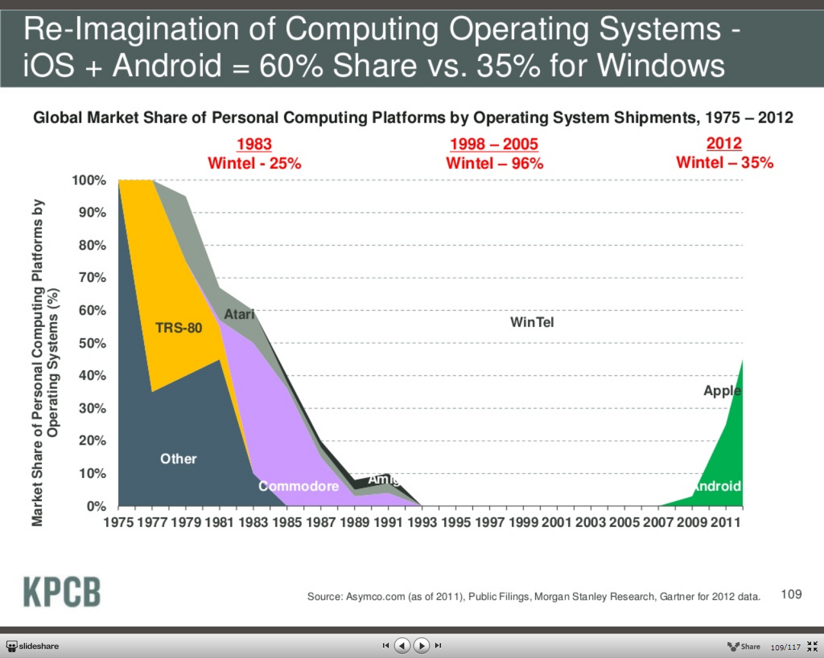
Changing Landscapes for Operating Systems

