Slide 1
Does Culture Effect Life Insurance Consumption?—With Evidence from Mainland China
WANYAN Ruiyun, YE Xiaolan and CHEN Tao
School of insurance
Southwestern University of Finance and Economics

Slide 2
Outline
Research Purpose and Importance
Cultural dimensions
Questionnaire survey
Research Methodology and Data
Regression Results
Findings

Slide 3
Research purpose and its importance(1)
This cross-disciplinary study examines the way culture affects consumption patterns of life insurance across Chinese provinces.

Slide 4
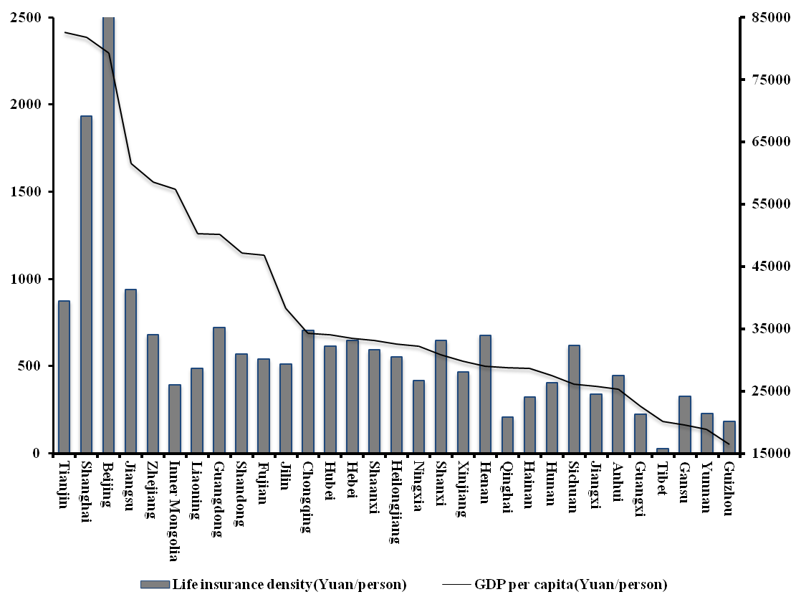
Figure 1 The National Income and Life Insurance Density in China, 2011

Slide 5
Research purpose and its importance(2)
In China, studies have been conducted to investigate the effect of economic and demographic determinants on life insurance demand. But these findings have their limitations.

Slide 6
Research purpose and its importance(3)
Because of the uncertainty and ambiguity inherent in the life insurance product, consumers are more likely to respond according to their cultural practice. (Crosby and Stephens, 1987)
There are studies on Hofstede’ cultural dimensions in mainland China, but few of them are related to life insurance consumption.

Slide 7
Cultural dimensions
According to Hofstede(1983), we divided the culture into four dimensions:
Power Distance Index (PDI). Power distance index is the inequality of power distribution accepted by a society.
Individualism Index (IDV). Individualism refers to the loose social relationships. In such society, people take care of their nuclear family.
Masculinity/femininity index (MAI).
Uncertainty avoidance index (UAI). The uncertainty avoidance index assesses the extent to which people feel threatened by uncertainty and ambiguity, and try to avoid these situations.

Slide 8
Questionnaire survey
The questionnaires are sampled at random. We authorize some companies to conduct the survey in 31provinces across mainland China. Up till now, we have got 37639 (1200 for each province) valid feedbacks.

Slide 9
 | PDI | IDV | MAI | UAI
Anhui | 88.98 | 56.38 | 51.53 | 30.29
Beijing | 71.6 | 51.48 | 69.49 | 31.39
Chongqing | 89.9 | 41.19 | 54.76 | 32.87
Fujian | 93.55 | 54.77 | 60.68 | 29.57
Gansu | 95 | 37.5 | 87.5 | 25.5
Guangdong | 70.2 | 45 | 63.8 | 32.7
Guangxi | 94.52 | 35 | 77.17 | 36.24
Guizhou | 79.22 | 40.49 | 61.76 | 29.82
Hainan | 90 | 69.44 | 57.41 | 30.56
Hebei | 72.78 | 71.97 | 58.33 | 35.29
Heilongjiang | 87.5 | 37.5 | 56.25 | 32.5
Henan | 85.17 | 45.25 | 50 | 34.48
Hubei | 81.73 | 45.9 | 69.47 | 36.46
Hunan | 91.76 | 53.01 | 56.94 | 29.91
Inner Mongolia | 93.03 | 44.12 | 84.03 | 30.53
Jiangsu | 93.05 | 53.52 | 69.92 | 32.55
Jiangxi | 88.66 | 45.1 | 30.41 | 31.67

Slide 10
 | PDI | IDV | MAI | UAI
Jilin | 75.83 | 58.33 | 66.67 | 39.5
Liaoning | 73.66 | 60.56 | 64.87 | 37.63
Ningxia | 91.05 | 46.67 | 34.29 | 38.8
Qinghai | 95.23 | 33.23 | 41.41 | 29.29
Shaanxi | 86.93 | 31.79 | 40.36 | 38.55
Shandong | 77.09 | 53.54 | 57.09 | 34.75
Shanghai | 71.95 | 49.5 | 87.5 | 39.5
Shanxi | 73.33 | 75 | 61.67 | 36
Sichuan | 81.23 | 48.11 | 60.61 | 31.6
Tianjin | 74.55 | 42.73 | 70.91 | 34.79
Tibet | 86.96 | 47.28 | 50 | 38.51
Xinjiang | 71.38 | 53.13 | 67.19 | 39.15
Yunnan | 84.59 | 53.32 | 44.39 | 32.71
Zhejiang | 76.2 | 44.42 | 54.69 | 33.94
Mainland China | 79.30 | 47.64 | 61.02 | 32.79
Hofstede（2004） | 80 | 20 | 66 | 30
^{[1]}Source: http://geert-hofstede.com/china.html。

Slide 11
Research Methodology
We use the panel data of 31 provinces across China from 1999-2010, analyze the effect of cultural differences on life insurance consumption there, so as to find out whether the culture in mainland China has significant effect on life insurance consumption.
Method: Pooled EGLS

Slide 12
Source of Data
Variable | Description | Data Source
Life Insurance Pen / Den | Life Insurance Penetration (Pen) is measured as the percentage of life insurance premium to Gross Domestic Product. Life Insurance Density (Den) is calculated as the percentage of total life insurance premium to total population | Provincial Statistical Yearbook: 2000-2011 China Insurance Statistics Yearbook: 2000-2011
Cultural Variable | PDI, IDV, MAI, UAI | Hofstede（1983,2001,2004）, Questionnaire on 31 provinces
GDP per capita | The percentage of GDP to total population | Provincial Statistical Yearbook: 2000-2011
Expected Inflation Ratio | Consumer Price Index instead, last year was 100, Inf. | Provincial Statistical Yearbook: 2000-2011
Bank | Banking Sector Development. The percentage of total banking assects to GDP. Bank | Provincial Statistical Yearbook: 2000-2011 China Financial Statistics Yearbook: 2000-2011
Minority | Dummy Variable. It equals to 1 when there are 3 or more minority counties, or when the percentage of minorities to the total population is over 8%. Otherwise, it equals to 0. Min. | China Population Statistics Yearbook: 2000-2011
DEP | Dependency Ratio. Refers to refers to the population aged 0-14, 65 and over as percentage of the population aged 15-64 | China Population and Employment Yearbook: 2000-2011

Slide 13
Hypothesis
Hypothesis 1: The life insurance consumption is negatively related to the level of power distance.
Hypothesis 2: The life insurance consumption is negatively related to the level of individualism.
Hypothesis 3: The life insurance consumption is positively related to the level of uncertainty avoidance.

Slide 14
Equation

Slide 15
Regression Results (1)
Dependent Variable: pen Method: Pooled EGLS (Cross-section weights)
 | c | pdi | idv | mai | uai | lngdp
Eq₁ | -2.081* |  |  |  |  | 0.0799***
T | -2.283 |  |  |  |  | 1.798
Eq₂ | -0.035 | -0.007* | 0.00026 | 0.009* | -0.028* | 0.051***
T | -0.040 | -3.073 | -0.105 | -6.357 | -5.245 | -1.727
 | inf | bank | min | dep | F-statistic | Adjusted R²
Eq₁ | 0.0287* | 0.449* | -0.248* | -1.731* | 73.441 | 0.494
T | 3.319 | 10.594 | -5.029 | -4.207
Eq₂ | 0.022* | 0.461* | -0.22* | -2.001* | 53.364 | 0.570
T | 3.060 | 12.140 | -3.861 | -5.136

Slide 16
Regression Results (2)
Dependent Variable: pen Method: Pooled EGLS (Cross-section weights)
 | C | pdi | idv | mai | uai | lngdp
Eq₁ | -4.521* |  |  |  |  | 1.045*
T | -10.917 |  |  |  |  | 30.091
Eq₂ | -7.065* | -0.004** | -0.001 | 0.007* | -0.015* | 1.040*
T | -7.495 | -1.823 | -0.758 | 5.207 | -2.159 | 29.230
 | Inf | bank | min | dep | F-statistic | Adjusted R²
Eq₁ | 0.031* | 0.253* | -0.271* | -1.431* | 785.4099 | 0.913581
T | 4.364 | 10.086 | -6.769 | -4.363
Eq₂ | 0.030* | 0.229* | -0.185* | -1.133* | 487.1534 | 0.923731
T | 4.419 | 7.238 | -3.389 | -3.504

Slide 17
Findings
Cultural dimensions are significantly related to the difference in life insurance consumption.
Power distance plays a significantly negative role in explaining the regional differences in life insurance consumption. But its coefficient is comparatively small
Individualism does not show significant effect.
The masculinity/femininity index is significantly positive.
Somewhat surprising is the negative significance of uncertainty-avoidance dimension.

Slide 18
Further Discussion
Our study has some limitations. First, because of data availability problems, we do not include in our analysis all the variables that may affect life insurance consumption, such as institutional variables, the level of education, and pricing variables. Second, the questionnaire does not have enough samples, which needs to be enlarged in the future, so as to better support our findings.

Slide 19
Thank you and Questions?

