Slide 1
Questioning Moral Hazard in Agricultural Insurance: Non-Evidence from a Quasi-Natural Experiment on Livestock Insurance in China
Yuehua Zhang
Zhejiang University, China
Xi Zhu
Shanghai Jiao Tong University, China
Calum Turvey
Cornell University
July 19, 2013

Slide 2
Introduction
China’s Pork production consists of about ½ of the world, while its consumption consists of about ½ of the world.
Most of the Chinese pig producers are small farmers, who are vulnerable to various risks, such as death risk of hog or swine, and price risk.
This leads to volatile pork supply and price in China in recent years.

Slide 3
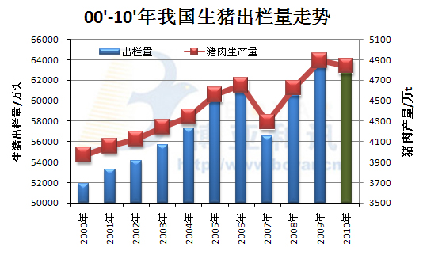
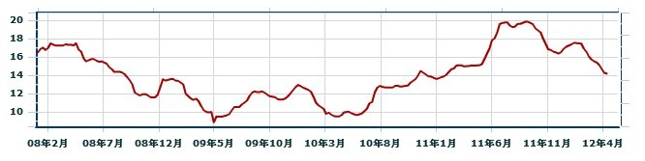
hog supply in China 2000-2010
Price of pork in China 2008-2012

Slide 4
Introduction
Aiming at protecting the farmers from big loss caused by death of hog or swine, the Chinese government began to conduct a subsidized Pig Insurance program (PI) from 2007.
Questions:
Is moral hazard problem severe in pig insurance?
Does the program significantly increase the production?
Could this program be sustainable and be extended to more farmers in the future?

Slide 5
Introduction
However, evaluating the casual impact of PI program is a challenging task.
  Self selection: Farmers with certain traits may self select into the insurance program, and these traits may affect the choice of production output.

Slide 6
Introduction
We used a quasi-natural experiment in Deqing County to identify the effect of PI program.
With a two period (2009-2010) panel data for hog and swine raisers, we use propensity score matching method to estimate PI’s impact on
  Moral hazard - vaccine use and mortality.
  Production

Slide 7
Literature Review
Two different methodologies had been applied to study the impacts of microfinance in literature.
Non-experiment data
Smith and Goodwin(1996) use a sample of Kansas dryland wheat farmers, and found that moral hazard incentives lead insured farmers to use fewer chemical inputs to prevent decreasing yield.
Goodwin et al.(2004) found that increased participation in insurance programs provokes statistically significant acreage responses in some cases, though the response is very modest in every case.

Slide 8
Literature Review
Randomized field experiment
Cai et al.(2010) was conducted in southwestern China in the context of insurance for swines.
  Providing insurance significantly increases farmer’ tendency to raise swines

Slide 9
Literature Review
Remark on literature
Extensive margin vs Intensive margin
Endogeneity – self selection
Moral hazard
Our studies
Quasi- natural experiment in Qeqing Couty
Difference in Difference change that can control individual heterogeneity
Insurance effect on moral hazard and production

Slide 10
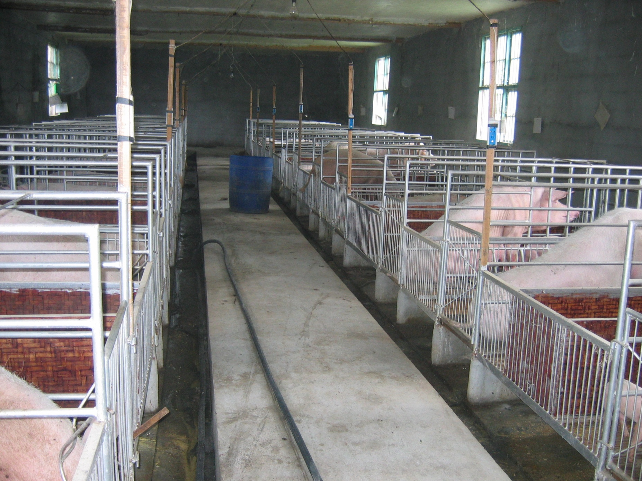
hog

Slide 11
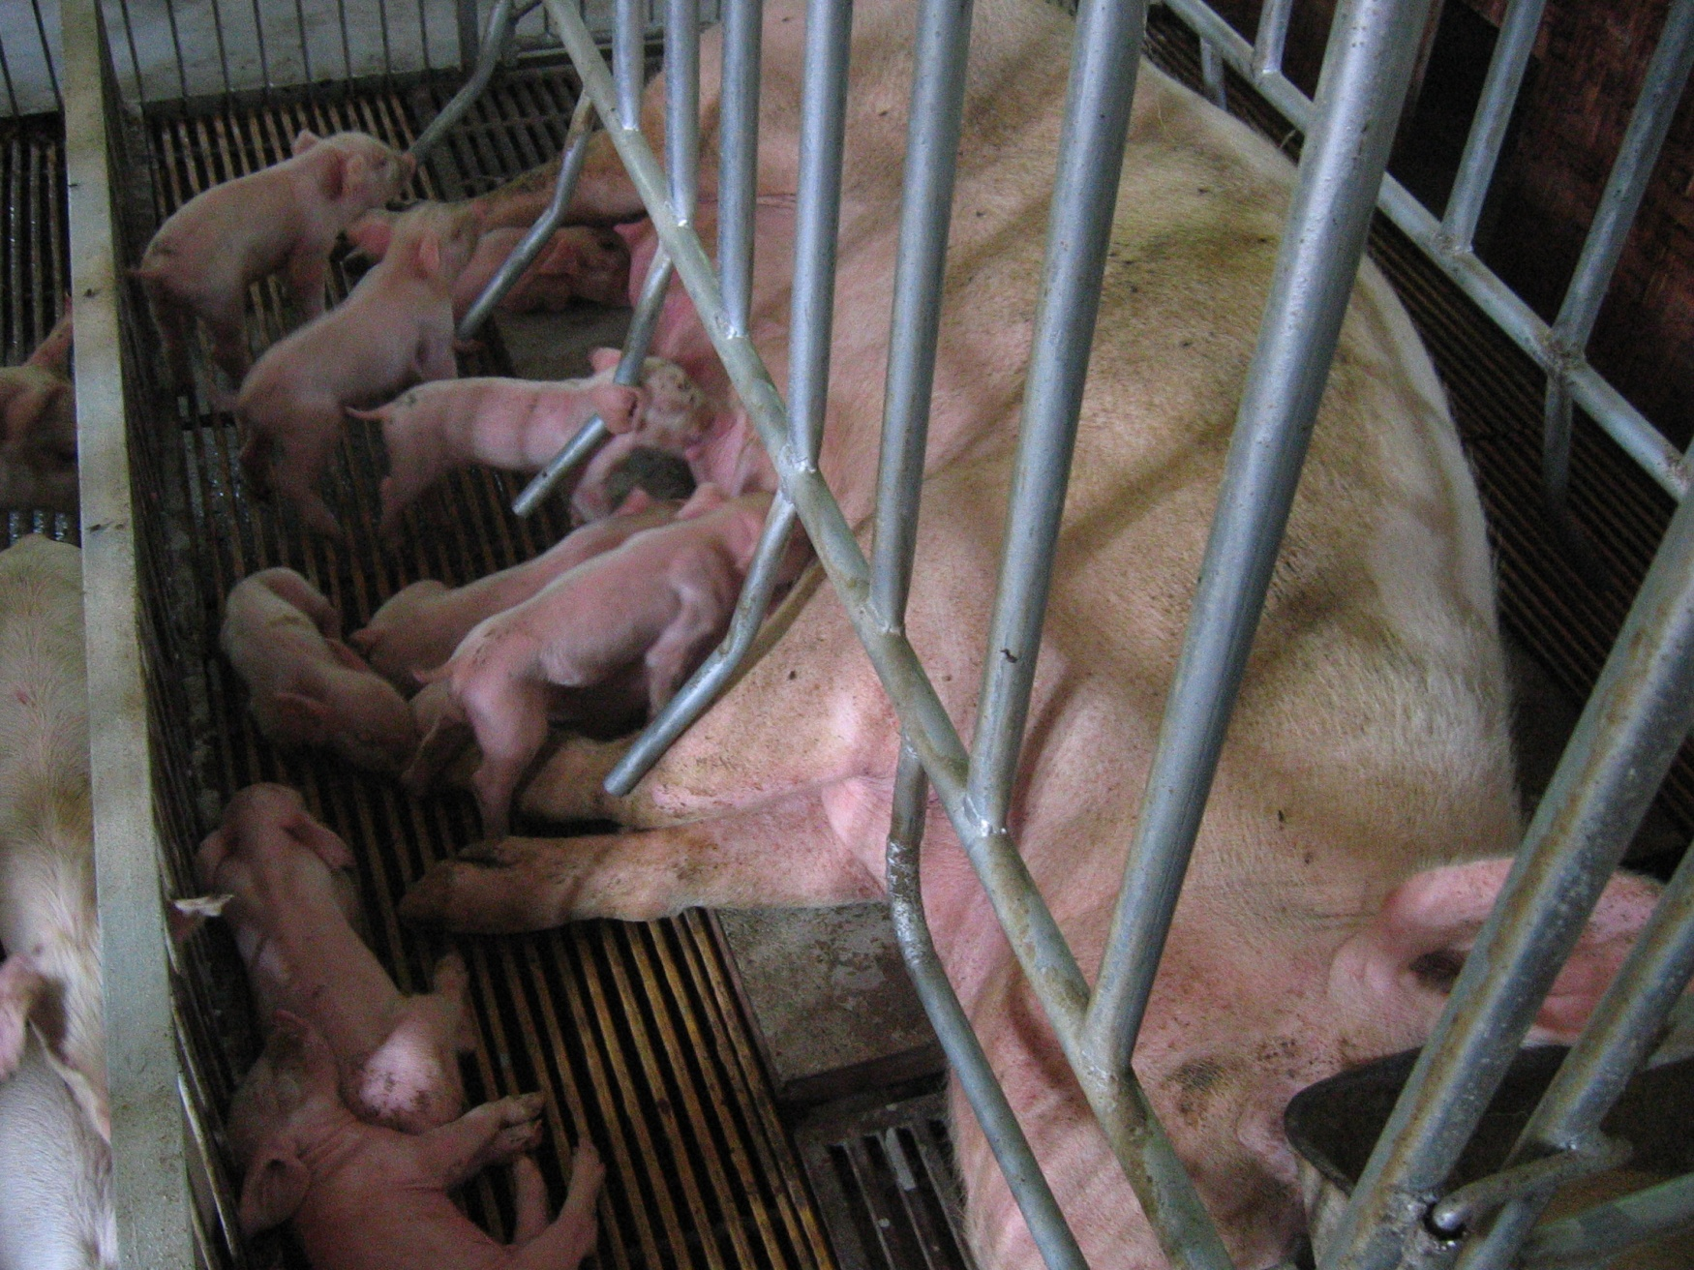
swine

Slide 12
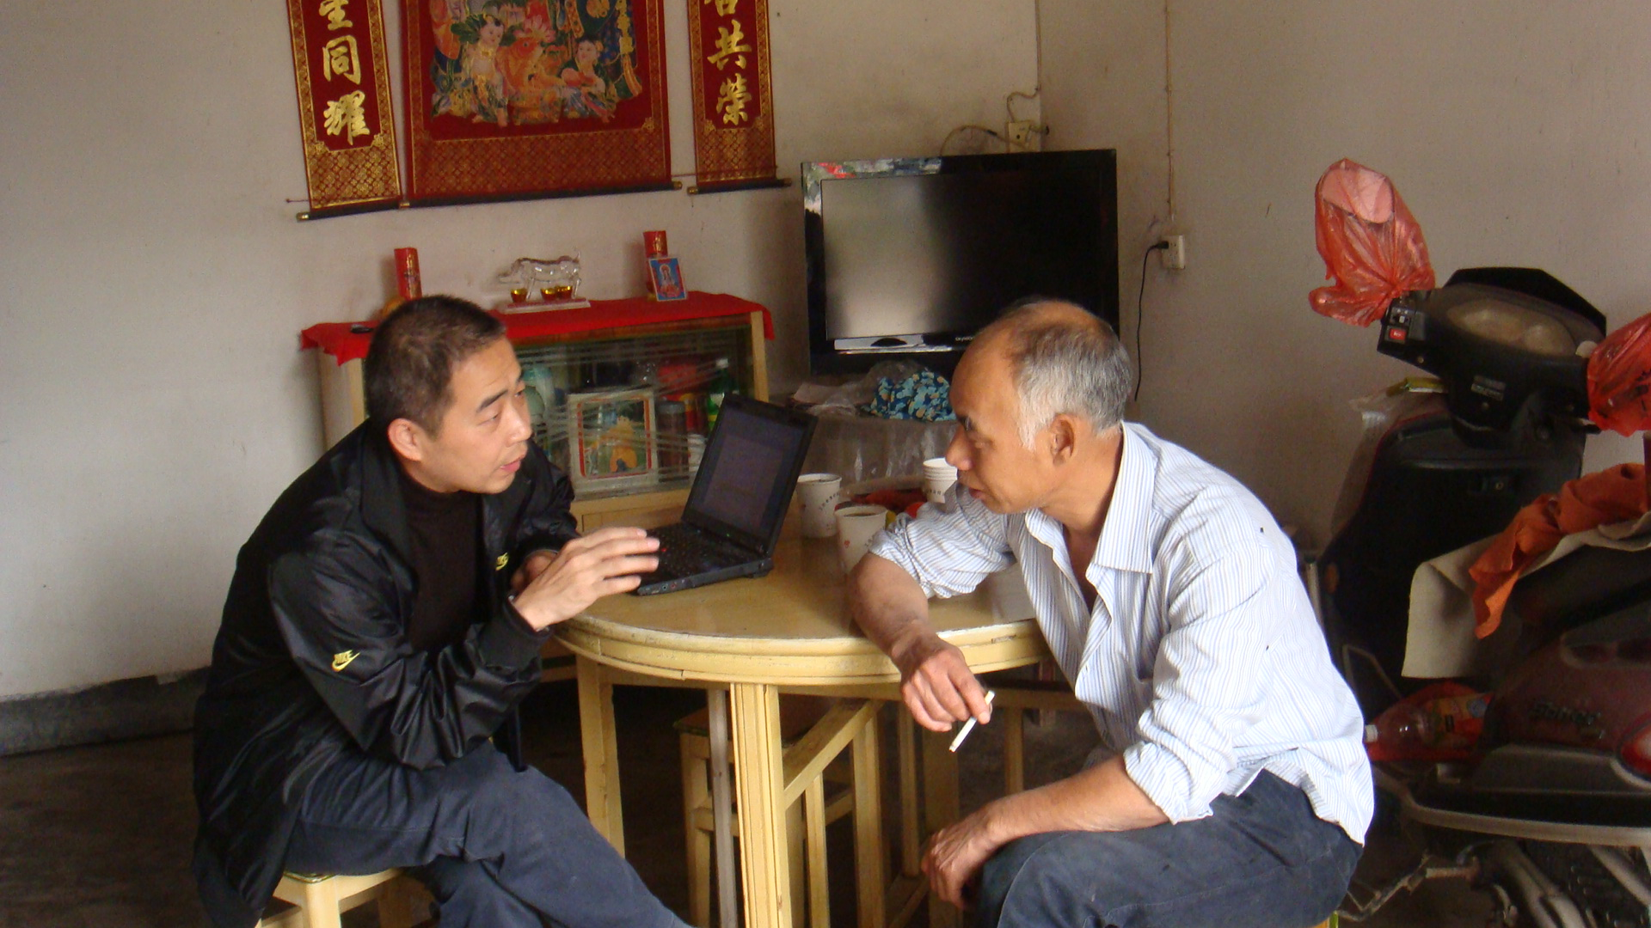
survey

Slide 13
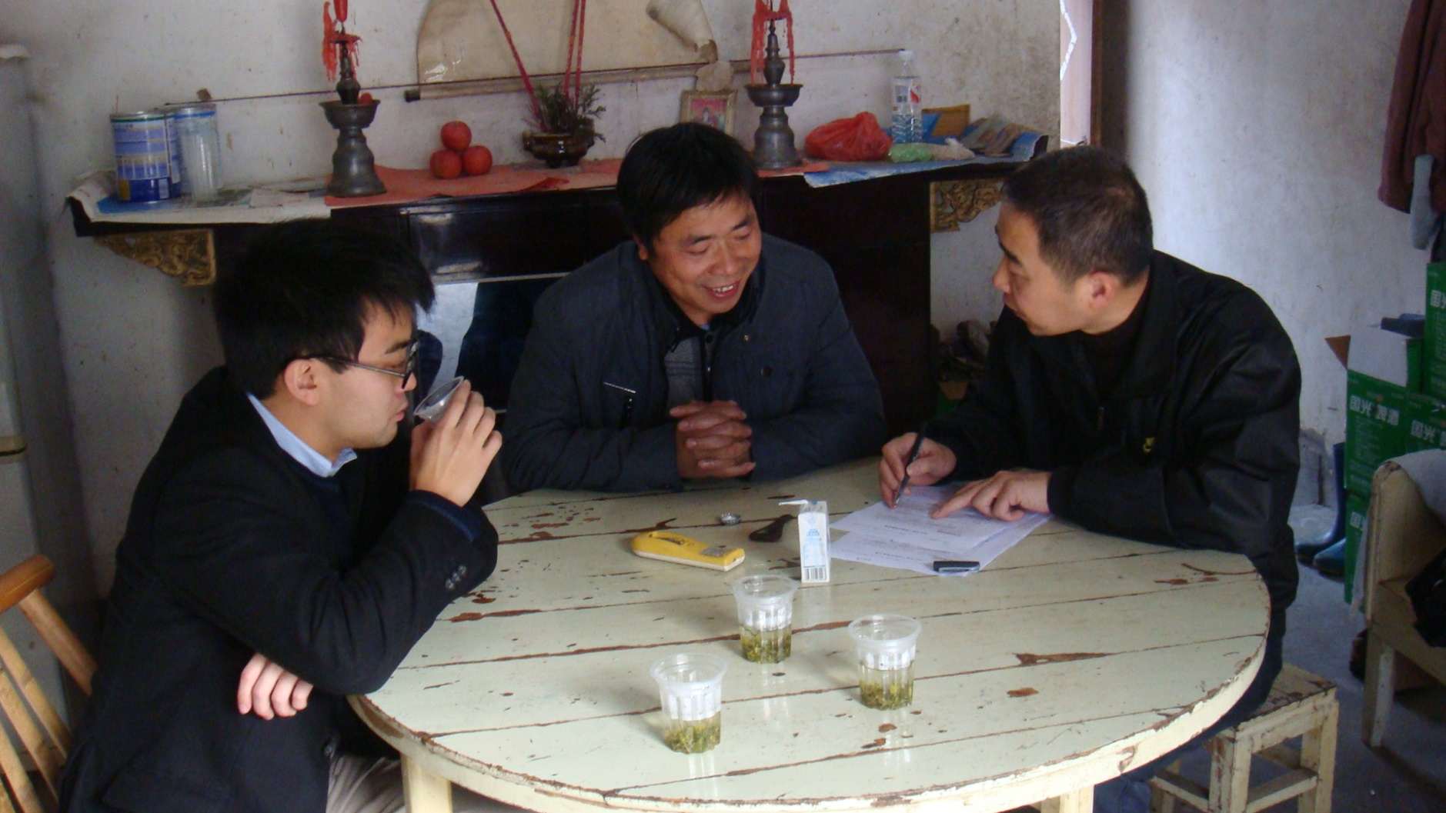
survey

Slide 14
The PI program in Deqing
  In Deqing , the government conduct the pilot insurance program for pig insurance from 2006 to 2009, after which it becomes a regular policy.
  The subsidized program
    65% subsidy from hog insurance
    80% subsidy from swine insurance
  Ex. Hog
    Market price 2000, Indemnity 600.
    Farmer pays premium 6.3 (of 18), with the remaining paid by government

Slide 15
The PI program in Deqing
Policy change in 2010
During the pilot program period, both small and big farmers had equal opportunity to be purchase insurance
After this period, small farmers were less likely to access insurance.
The insurance companies tend to serve bigger farmers in order to maximize their profits.

Slide 16
Research Idea
Total pig farmers
Quit Insurance
(Treatment)
2009 Farmers who buy insurance with more than 100 finish hogs per year
DiD method
Propensity Score
2010 Farmers who buy insurance with more than 200 finish hogs per year
With Insurance
(Control Group)

Slide 17
Figure 2. distribution of size for insured farmers

Slide 18
Figure 2. distribution of size for insured farmers

Slide 19
Empirical Model
Let d denote the dropout of insurance
Propensity Score Matching Method (Wooldridge, 2002)
β₁ measures the effect of dropout of insurance

Slide 20
Data and background
The data of this study was obtained from the Pig epidemic census conducted by the Deqing County government in 2009 and 2010.
It surveys agricultural households with more than 100 herds.
There are 531 households in the survey, which leads to a sample of 405 households.
Insurance policy change in 2010. Many smaller farmers (below 100 finish hogs) were dropped out from insurance service in 2010.

Slide 21
Basic statistics
 |  |  | 2009 |  | 2010
variable | defintion | obs | mean | sd | mean | sd
numhog | Number of hogs | 405 | 646.42 | 1102.79 | 752.55 | 1403.33
numswine | Number of swines | 405 | 56.25 | 85.67 | 72.48 | 228.77
inshog | Insurance status of hogs | 405 | 0.23 | 0.42 | 0.11 | 0.31
insswine | Insurance status of swines | 405 | 0.31 | 0.46 | 0.11 | 0.31
vac_hog | Vaccine use on hogs | 405 | 5.82 | 6.13 | 6.49 | 13.41
vac_swine | Vaccine use on swines | 405 | 21.5 | 16.95 | 19.2 | 27.39
age | Age | 405 | 45.99 | 7.45 | 47.81 | 7.45
edu | Education (year) | 405 | 7.18 | 2.51 | 7.05 | 2.63
expe | Breeding experience | 405 | 8.58 | 4.68 | 9.25 | 4.31
incratio | Income from hog(swine) /total income | 405 | 75.66 | 20.13 | 75.57 | 23.57
Table 1. Variable Definitions and Summary Statistics

Slide 22
Data
Group | Status | Hog | swine
Group1 | 09 ins, 10 not | 64 | 91
Group2 | 09 ins, 10 ins | 31 | 34
Group3 | 09 not, 10 ins | 12 | 9
Group4 | 09 not, 10 not | 296 | 266
Total |  | 403 | 400
Table 2. Insurance Status of Surveyed Farmers

Slide 23
Data
Group | age | edu | expe | incratio | Number of hog/swine | Death of hog/swine | Loss ratio of hog/swine
Hog
Group 1 | 45.41 | 7.86 | 9.61 | 79.44 | 1091.86 | 0.95 | 0.68
(treat) | 6.33 | 2.86 | 4.72 | 19.74 | 1730.90 | 0.21 | 0.99
Group 2 | 46.35 | 8.13 | 10.84 | 81.45 | 2111.29 | 1.00 | 0.62
(control) | 6.85 | 3.08 | 5.21 | 17.52 | 2269.93 | 0.00 | 0.55
Group 3 | 44.00 | 8.17 | 7.25 | 77.50 | 941.92 | 1.00
 | 6.99 | 2.82 | 4.29 | 20.94 | 1021.07 | 0.00
Group 4 | 46.28 | 6.88 | 8.23 | 74.47 | 389.08 | 0.86
 | 7.61 | 2.30 | 4.52 | 20.03 | 348.47 | 0.34
swine
Group 1 | 45.87 | 7.42 | 8.81 | 79.00 | 66.25 | 0.62 | 0.46
(treat) | 7.45 | 2.68 | 4.30 | 18.95 | 90.16 | 0.49 | 0.53
Group 2 | 46.56 | 8.32 | 11.32 | 83.88 | 175.44 | 0.91 | 0.51
(control) | 5.33 | 3.03 | 5.60 | 17.17 | 196.02 | 0.29 | 0.33
Group 3 | 46.33 | 7.33 | 6.67 | 72.22 | 80.33 | 0.78
 | 8.51 | 2.87 | 4.80 | 19.86 | 69.55 | 0.44
Group 4 | 45.94 | 6.91 | 8.19 | 73.80 | 37.84 | 0.46
 | 7.71 | 2.32 | 4.55 | 20.53 | 34.93 | 0.50
Table 3. Selection on Treat Group and Control Group
Mean and standard error provided for each variable, which are calculated by data of the first year(2009).

Slide 24
Empirical Results
 | Treat (hog) | Treat (swine)
ln(init scale) | -0.553*** | -0.608***
 | (-3.167) | (-3.610)
init loss ratio | -0.06 | -0.285
 | (-0.339) | (-0.988)
age | -0.033 | -0.033
 | (-1.380) | (-1.522)
edu | 0.015 | -0.035
 | -0.267 | (-0.644)
expe | -0.024 | -0.017
 | (-0.698) | (-0.414)
_cons | 5.994*** | 5.326***
 | -3.22 | -3.698
N | 95 | 125
Pseudo R-sq | 0.127 | 0.179
insurance companies use scale to decide whether to drop out
Table 4. Who would be Rejected
t statistics in parentheses * p<0.10, ** p<0.05, *** p<0.01

Slide 25
Insurance Impact on Vaccine Use
Treat | 0.652* | 0.391 | -0.117 | -0.288
 | -1.977 | -1.268 | (-0.365) | (-1.017)
pscore | -1.690** |  | -0.821
 | (-2.023) |  | (-1.154)
_cons | 0.143 | -0.822*** | 0.004 | -0.470*
 | -0.266 | (-3.248) | -0.008 | (-1.944)
N | 95 | 95 | 125 | 125
R-sq | 0.059 | 0.017 | 0.019 | 0.008

Slide 26
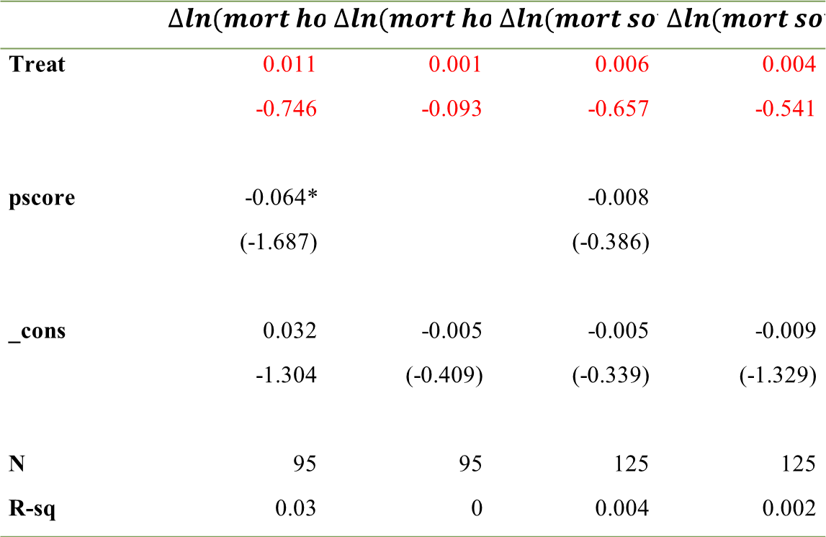
Insurance Impact on Mortality Rate
 | $$∆ln(mort hog)$$ | $$∆ln(mort hog)$$ | $$∆ln(mort sow)$$ | $$∆ln(mort sow)$$
Treat | 0.011 | 0.001 | 0.006 | 0.004
 | -0.746 | -0.093 | -0.657 | -0.541
pscore | -0.064* |  | -0.008
 | (-1.687) |  | (-0.386)
_cons | 0.032 | -0.005 | -0.005 | -0.009
 | -1.304 | (-0.409) | (-0.339) | (-1.329)
N | 95 | 95 | 125 | 125
R-sq | 0.03 | 0 | 0.004 | 0.002

Slide 27
Insurance Impact on Production
Treat | -0.310** | -0.228* | -0.001 | -0.018
 | (-2.498) | (-1.971) | (-0.013) | (-0.314)
pscore | 0.536* |  | -0.084
 | -1.704 |  | (-0.568)
_cons | -0.144 | 0.163* | 0.170* | 0.121**
 | (-0.708) | -1.716 | -1.706 | -2.406
N | 95 | 95 | 125 | 125
R-sq | 0.069 | 0.04 | 0.003 | 0.001

Slide 28
Conclusion
Vaccine use for hogs increased significantly after the withdrawal of insurance, while it is not significant for swines.
Access to insurance significantly increases the hog production, but not significant for the swine production.
  swine is like capital for farmers
Insurance optimizes farmers’ production behavior for the mortality of hogs are not significant.

Slide 29
Robust Check – bigger control group
Group 1 (09 ins, 10 dropped not) as treat, Group 2 and 4 (09 ins, 10 ins; 09 no ins, 10 no ins) as control
The results are robust.

Slide 30
Robust check - the Balancing Hypothesis test
 | Block 1 | P(X) <0.5 | t Test | Block 2 | P(X) >0.5 | t Test
 | Treat | Control | (P value) | Treat | Control | (P value)
Initnumhog | 8.17 | 8.05 | 0.78 | 6.69 | 6.39 | 0.10
Initlossratiohog | 0.51 | 0.39 | 0.64 | 0.69 | 0.70 | 0.95
Age | 50.18 | 49.60 | 0.87 | 47.65 | 46.88 | 0.68
Edu | 8.82 | 8.20 | 0.66 | 7.75 | 7.98 | 0.76
Exper | 1.70 | 2.73 | 0.29 | 11.2 | 9.69 | 0.11
Table 7. Balancing Hypothesis Test for Hog Insurance Dropout
It implies that the matching is not bad.

Slide 31
Robust check
 | Block 1 | P(X) <0.5 | t Test | Block 2 | P(X) 0.5-0.75 | t Test
 | Treat | Control | (P value) | Treat | Control | (P value)
Initnumhog | 5.76 | 5.62 | 0.73 | 4.55 | 4.52 | 0.84
Initlossratiohog | 0.53 | 0.66 | 0.37 | 0.43 | 0.64 | 0.15
Age | 46.82 | 52.25 | 0.13 | 50.20 | 46.92 | 0.13
Edu | 10.45 | 9 | 0.30 | 7.86 | 8 | 0.87
Exper | 13.27 | 13.25 | 0.99 | 13.13 | 11.44 | 0.11
 | Block 3 | P(X) >0.75 | t Test
 | Treat | Control | (P value)
Initnumhog | 3.47 | 3.33 | 0.51
Initlossratiohog | 0.65 | 0.37 | 0.17
Age | 47.5 | 47.8 | 0.91
Edu | 6.38 | 6.98 | 0.58
Exper | 7.75 | 9.01 | 0.22
Table 8. Balancing Hypothesis Test for swine Insurance Dropout

Slide 32
Implication
The moral hazard problem is not severe in Chinese livestock insurance market, for the relatively professional hog/swine farmers.
Insurance is a useful tool to reduce farmer’s risk and stimulate the pig production. But it has enough effect on the current raisers’ production at the intensive margin
  It’s similar to Goodwin(2004)’s result.
  it supplements Cai et. al (2010)’s work, who found insurance helps in the extensive margin.

Slide 33
Future Research: Issues
farmers production behavior:
(1) vaccine usage
(2)finish hogs outcome
(3)anti-biotics and other animal drugs usage
(4) micro credit based on pig insurance
(5) Precautionary savings

Slide 34
Natural Experiment Design
13 towns
11 towns
2 towns
Improve insured sum from 500 to 600 RMB/hog
A
250 samples
Compulsory insurance
500 samples
250 samples
B
C
D
Insured sum 500 RMB/hog

Slide 35
Random Sampling
1. Choosing 2 towns from 13 towns (Exogenous)
2. Rank Population of pig farmers with sow number.
3. Random choose 1000+ samples by Equidistant sampling
4. Random choose 5 villages from 2 insurance town to improve the insured sum to 600 RMB

Slide 36
First Year
First Year
Second Year
Study effect

Slide 37
Follow up survey
T1: Survey before Insurance (July, 2013)
T2: Survey after first year insurance pilot (July, 2014)
T3: Survey after Second year Insurance Pilot (July, 2015)

Slide 38
Comments and Suggestions are welcome!
This research is funded by NSFC(70873102), China Insurance and Risk Management Center of Tsinghua SEM

