Slide 1
A Study on the Risk-Adjusted Insurance Market Equilibrium and Regulation Coordination
By Alex
2013-07-19

Slide 2
Contents
1. Introduction
2. Solvency and rate regulation
3. Supply, demand and insurance market equilibrium
4. Risk-based insurance regulation coordination
5. Conclusions

Slide 3
Introduction
Insurance regulation has been an important topic for academic researchers.
Not much research on coordination of different regulatory activities.
Different regulatory policies do have simultaneous impact on insurers’ operation and market equilibrium

Slide 4
Solvency and rate regulation
Solvency Regulation
The insurer’s real capital should meet minimum capital requirement.
Minimum Capital:
The amount of capital that is required by the regulator, for insurers to overcome the influence from underwriting risk and investment risk.
Real Capital:
The difference between identified assets and identified liability, while identified assets should be calculated based on the risk level of the assets.

Slide 5
Solvency and rate regulation
Rate Regulation
There has been two basic rationales for insurance rate regulation
To avoid underpricing problem:
Competition among insurers could lead to the underpricing problem, which could cause insolvency issues of insurers.
To avoid monopoly pricing:
Insurers could form cartels to increase price, which could harm the welfare of consumers.

Slide 6
Solvency and rate regulation
Rate Regulation
China’s rate regulation for auto insurance has been aimed at the first one
Three periods of rate regulation relaxation:
1988-1993: failed
2001-2006: failed
2011-:

Slide 7
Supply, demand and insurance market equilibrium
The Model - Demand

Slide 8
Supply, demand and insurance market equilibrium
The Model - Supply
Premium + Investment Return =
Expected Loss + Operating Expenses + Required Capital Return

Slide 9
Supply, demand and insurance market equilibrium
The Model – Supply (Operating Expenses)

Slide 10
Supply, demand and insurance market equilibrium
The Model – Supply (Inv. & Capital)
Risk-free Asset:
Risky Asset:

Slide 11
Supply, demand and insurance market equilibrium
The Model – Supply Function

Slide 12
Supply, demand and insurance market equilibrium
The Model – Supply Function

Slide 13
Supply, demand and insurance market equilibrium
The Model – Supply Curve
Insurance Supply q
Supply
Solvency
Insurance Rate π

Slide 14
Supply, demand and insurance market equilibrium
The Model – Equilibrium

Slide 15
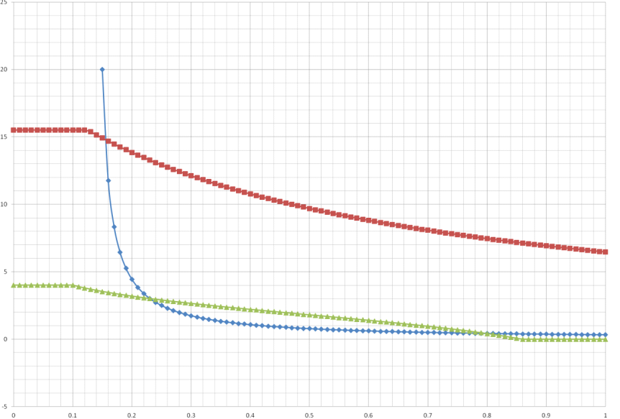
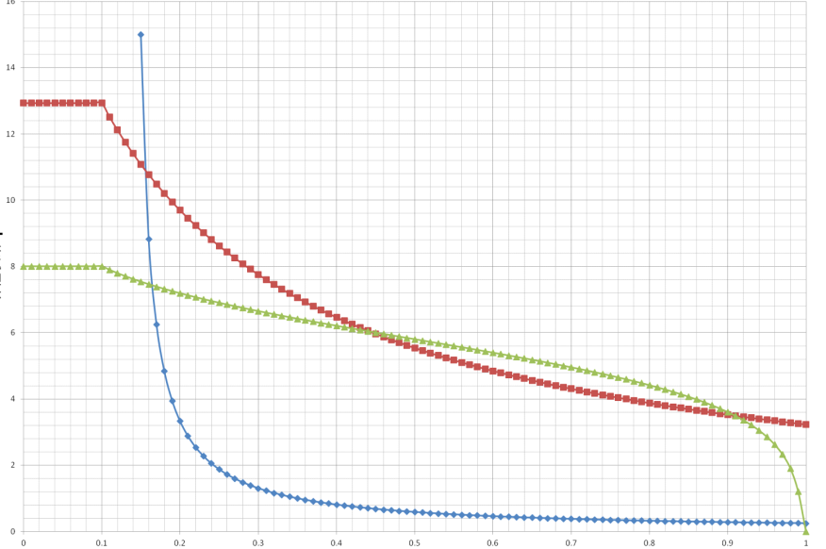
Supply, demand and insurance market equilibrium
The Model – Equilibrium
Multiple Equilibriums:

Slide 16
Supply, demand and insurance market equilibrium
The Model – Equilibrium
Unique Equilibrium:
No Equilibrium

Slide 17
Risk-based insurance regulation coordination
Regulatory Influence: Rate Regulation
Supply
Demand
Solvency
Constraint

Slide 18
Risk-based insurance regulation coordination
Regulatory Influence: Solvency Regulation

Slide 19
Risk-based insurance regulation coordination
Regulation Coordination
1. Regulation policies should go with the market condition
Supply
Supply
Solv
Const
Demand
Solvency
Constraint
Demand

Slide 20
Risk-based insurance regulation coordination
Regulation Coordination
2. Solvency regulation need the relaxation of rate regulation
Supply
Supply
Demand
Demand
Solvency
Constraint
Solvency
Constraint

Slide 21
Thanks!

