Slide 1
Relationship between Property insurance and Economic Growth with Different Industry Agglomeration
--An Empirical Analysis Based on Panel Threshold Regression
Yuan Yuan and Tan Yi
School of Insurance, Central University of Finance and Economics
Beijing, China
July 19, 2013

Slide 2

Outline of Topics
1
Introduction
2
Review of Literatures
3
Model and Variables
4
The Empirical Analysis
5
Conclusion and Suggestion
6
Reference

Slide 3
Introduction
Review of Literatures
Model and Variables
The Empirical Analysis
Conclusion and Suggestion
Method
Data
Method
Herfindahl-Hirschman Index (HHI)
Panel Threshold Model
tool--Stata12

Slide 4
Introduction
Review of Literatures
Model and Variables
The Empirical Analysis
Conclusion and Suggestion
Method
Data
Data
2007-2012 Yearbook of China Insurance
2007-2012 Yearbook of China Statistical

Slide 5
Introduction
Review of Literatures
Model and Variables
The Empirical Analysis
Conclusion and Suggestion
The insurance and economic growth
The views of foreign scholars
The insurance industry can promote economic growth.(Outreville,Tong)
There is a strong causal relationship between the property insurance and economic growth. And the property insurance plays a significant positive role in the economy. ( Arena )
The relationship shows much difference in different countries. (Ward et al)
Property insurance could promote economic growth, but it has much difference in Western, Eastern and Central Europe. (Haiss and Kjell)

Slide 6
Introduction
Review of Literatures
Model and Variables
The Empirical Analysis
Conclusion and Suggestion
The insurance and economic growth
The views of the domestic scholars
The development of the insurance industry plays a role in promoting economic growth. (Lin Baoqing, Zhu Minglai)
Insurance significantly paly a "stabilizer" role in inhibiting economic fluctuations, but the "booster" role in economic growth was not obvious.(Tian Ling and Gao Jun)
He didn’t support the viewpoint that the development of insurance will promote economic growth. （Hu Hongbing）
The effect of non-life insurance industry to economic growth was not steady when we used different estimation methods. (Shao Quanquan)

Slide 7
Introduction
Review of Literatures
Model and Variables
The Empirical Analysis
Conclusion and Suggestion
The insurance and economic growth
The conclusion of Literatures
Most of domestic scholars use the smooth transition model, threshold regression methods to analyze the possible non-linear relationship between property insurance and economic growth. However, these problems will affect the accuracy of the conclusions and the acceptable level to a large extent.
Existing studies tend to ignore the specific situation of the industrial agglomeration degree in the various provinces.
Therefore, it is necessary to discuss this question under the premise of considering the degree of industrial agglomeration.

Slide 8
Introduction
Review of Literatures
Model and Variables
The Empirical Analysis
Conclusion and Suggestion
The threshold variable--HHI
Model and Variables
Fig 1:The HHI from 2007 to 2011

Slide 9
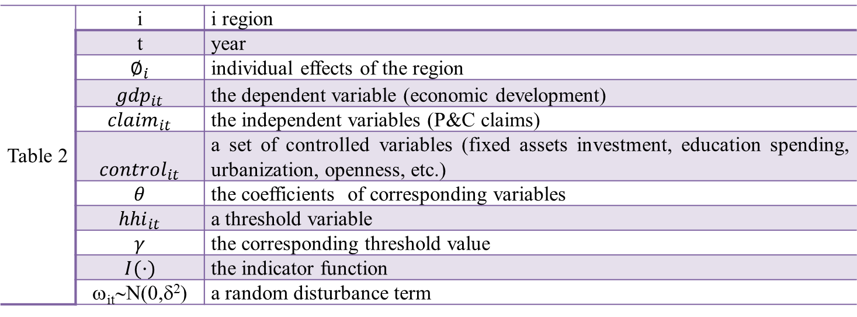
Introduction
Review of Literatures
Model and Variables
The Empirical Analysis
Conclusion and Suggestion
The threshold variable--HHI
Model and Variables
Model
Single threshold panel model
Multi-threshold panel model
Table 2 | i | i region
 | t | year
 | $$∅_{i}$$ | individual effects of the region
 | $${gdp}_{it}$$ | the dependent variable (economic development)
 | $${claim}_{it}$$ | the independent variables (P&C claims)
 | $${control}_{it}$$ | a set of controlled variables (fixed assets investment, education spending, urbanization, openness, etc.)
 | $$θ$$ | the coefficients of corresponding variables
 | $${hhi}_{it}$$ | a threshold variable
 | $$γ$$ | the corresponding threshold value
 | $$I(·)$$ | the indicator function
 | ω_{it}∼N(0,δ²) | a random disturbance term

Slide 10
Introduction
Review of Literatures
Model and Variables
The Empirical Analysis
Conclusion and Suggestion
The threshold variable--HHI
Model and Variables
Table 3:Variable definitions and calculation methods
Variable nature | Variable name | Variable Meaning | Method
Dependent variable | gdp | per capita gdp | GDP/total population
Independent variable | claim | insurance claims | Total property insurance claims/ total population
threshold variable | hhi | the degree of industry agglomeration | -
Control Variables | fi | per capita investment in fixed assets | Investment in fixed assets/ total population
 | edu | per capita investment in education spending | Education spending / total population
 | tra | per capita traffic mileage | Road and rail mileage / total population
 | open | openness | Total imports and exports / GDP
 | ubr | urbanization | Non-agricultural population/total population

Slide 11
Introduction
Review of Literatures
Model and Variables
The Empirical Analysis
Conclusion and Suggestion
The existence of the threshold panel
Threshold regression and theoretical analysis
The existence of the threshold panel
Table 4:Threshold effect test
Hypothesis test | F | P | 1% | 5% | 10%
H0: no threshold value; H1: there is a threshold | 4.0124** | 0.0300 | 6.4224 | 3.3114 | 2.2331
H0: there is a threshold value; H1: there are two threshold values | 1.6508 | 0.2000 | 5.4690 | 3.8409 | 2.7705
Notes: ***, **, * denote the 1%, 5%, 10% statistical significant level.
Table 5:The number of provinces in different years and interval
The range of HHI | 2007 | 2008 | 2009 | 2010 | 2011
hhi ≤0.3306 | 20 | 25 | 26 | 27 | 27
hhi＞0.3306 | 11 | 6 | 5 | 4 | 4
total | 31 | 31 | 31 | 31 | 31

Slide 12
Introduction
Review of Literatures
Model and Variables
The Empirical Analysis
Conclusion and Suggestion
The existence of the threshold panel
Threshold regression and theoretical analysis
Table 6: Estimates of model parameters
Variables | Coefficient | t-white | t-ols
lnfi | 0.4416 | 11.4041*** | 11.1216***
lnedu | 0.0306 | 0.8978 | 0.7141
lntra | -0.0167 | -0.6505 | -0.6067
lnopen | 0.0916 | 5.2020*** | 5.2721***
lnubr | 0.5884 | 8.1878*** | 7.3469***
lnclaim（≤0.3306） | 0.1550 | 3.8321*** | 3.6565***
lnclaim（>0.3306） | 0.0513 | 1.2358 | 1.0030
Note: ***, **, * represent 1%, 5%, 10% significant level.
t-white is the t values with the heteroscedasticity, t-ols is the t values with the homoscedasticity.

Slide 13
Introduction
Review of Literatures
Model and Variables
The Empirical Analysis
Conclusion and Suggestion
Conclusion
Suggestion
Conclusion
In this paper, empirical results show that the HHI has a significant threshold effect, and there is non-linear relationship between Chinese economic development and property insurance.
HHI ≤ 0.3306, the development of property insurance has the significant positive effect on economic growth.
HHI ＞0.3306, the development of property insurance has not the significant positive effect on economic growth .
So, in terms of the relationship between the economic development and property insurance in China, when the HHI is low, the development of property insurance can effectively promote economic growth in long-term .

Slide 14
Introduction
Review of Literatures
Model and Variables
The Empirical Analysis
Conclusion and Suggestion
Conclusion
Suggestion
Suggestion
Therefore, in making the relevant insurance policy, the HHI should be controlled in a reasonable threshold range, to let the development of property insurance promote the regional economic growth.

Slide 15
Reference
OurtreilleJ.f.,The Economic Significance of insurance Markets in Developing Countries[J].The Journal of Risk and Insurance,Vol57,1990.
Tong, Haizhi, 2008,“an investigation of the insurance sector's contribution to economic growth”, Doctoral Disserration, University of Nebraska.
Arena,M.,2006,“Does Insurance Market Activity Promote Economic Growth? A Cross-Country Study for Industrialized and Developing Countries”, World Bank Policy Research Working Paper,4098.
Ward,Damian,Zurbruegg,Ralf.Does Insurance promote economic growth-evidence from OECD Countries [J]. The Journal of Risk and Insurance, 2000 (4).
Esho,N.,Kirivsky A.Ward,D.and Zurbruegg, Law and the Determinants for Property-Casualty Insurance[J].The Journal of Risk and Insurance, 2004.
Peter Haiss，Kjell Sümegi.The relationship between insurance and economic growth in Europe: a theoretical and empirical analysis[J].Empirica,2008(35).
Hansen B E. Threshold Effects in Non-Dynamic Panels: Estimation, Testing, and Inference [J]. Journal of Econometrics, 1999(93).
Lin Baoqing, Hong Xixi, Wujiang Ming. An empirical Analysis of Demand Income Elastic Coefficient of Property Insurance in China [J]. Journal of Finance, 2004(7).
Zhu Minglai, Lu Yan, Kui Cao. The Determinants of Demand for Corporate Insurance in China: Empirical Analysis with Panel Data at Province Level [J].Journal of Finance, 2010(12).
Tian Ling, Gao Jun.Booster or stabilizer: an empirical analysis on the function of insurance industry to economic growth [J]. Insurance Studies, 2011(3).
[Hu Hongbing. A Cointegration analysis of the China Insurance Development and Economic Growth [J].Shandong Economy, 2007(6).
Shao Quanquan.Insurance Sectors Contribution to Economic Growth in China--A Study Based on Single Equation Estimation and Simultaneous Equation[J].Insurance Studies, 2012(4).
Martin,P. and G. Ottaviano, Growing Locations: Industry Location in a Model of Endogenous Growth[J].European Economic Review, 1999 (2).
Fujita,M. and J.Thisse,2002，Economics of Agglomeration: Cities, Industrial Location and Regional Growth, Cambridge: Cambridge University Press.
Brulhart,M. and F.Sbergami,2006,Agglomeration and Growth: Empirical Evidence, ETSG Working Paper,www.hec.uni.ch/mbrulhart /papers.
Bautista,A.D.2006,Agglomeration Economies，Economic Growth and the New Economic Geography in Mexico, Working Paper, Econ WPA, http: / /129.3.20.41 /ep2 /urb /papers /0508.
Sbergami,F.,2002, Agglomeration and Economic Growth: Some Puzzles, HEI Working Paper, No.2.

Slide 16

Thank you for your attention!

